Slide 1

First Cycle Fabrication
Alec Fredriksson
Shannon Lai
Simond Liu
Wilson Lam

Slide 2
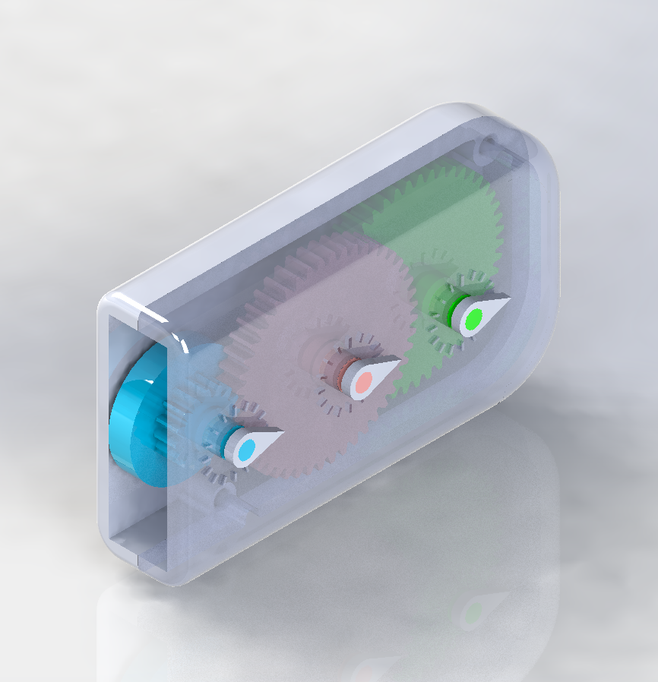
Idea and Cycle #1 CAD
Pocket Ruler
Purpose: Measure distance by rolling a wheel over a surface. Gears in the device translate this motion to a dial, which displays the total distance.
Intended to measure up to four feet with ¼” resolution.
Red Dial measures 1 foot
Green Dial measures 4 feet
Wheel
Dial Indicators

Slide 3
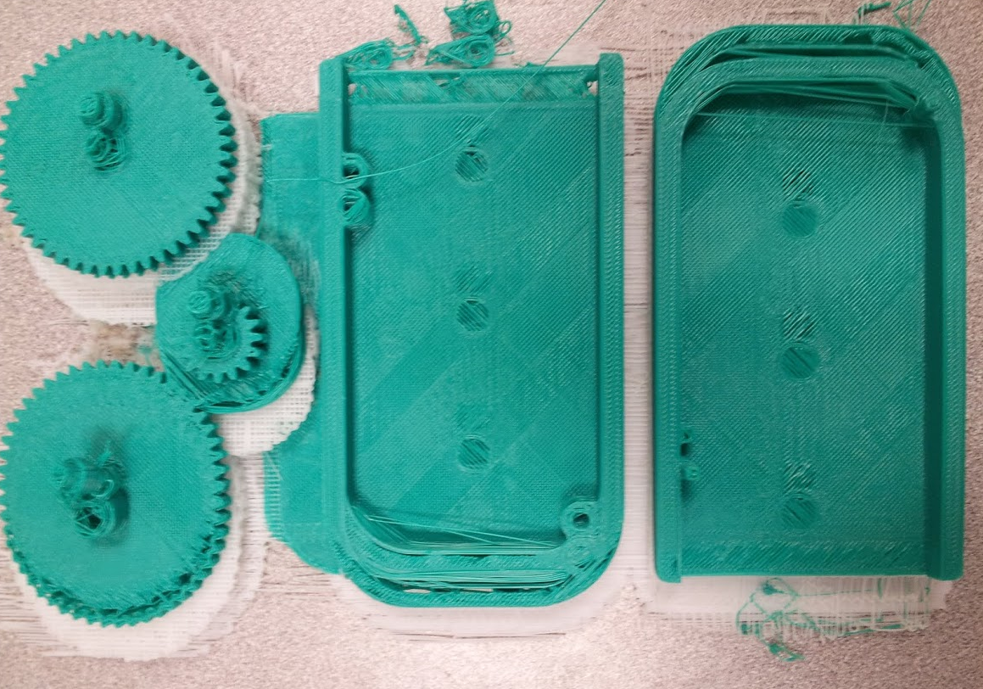
Cycle #1 Printed Parts
Shafts are not center,
but gear teeth are nicely defined
Indicators did not print well
Shifted printing

Slide 4
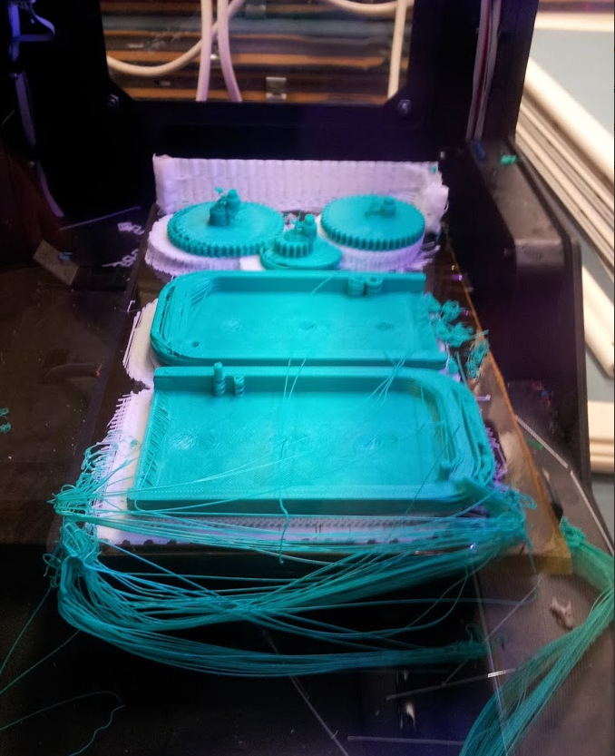
Lessons Learned
We suspect that the MakerBot software poorly handles printing several parts at once.
Process planning
Purge wall
Increase tolerances
Low expectations for gears, but it worked
Shafts of gears are not perfectly circular, which could lead to fitting problems

Slide 5
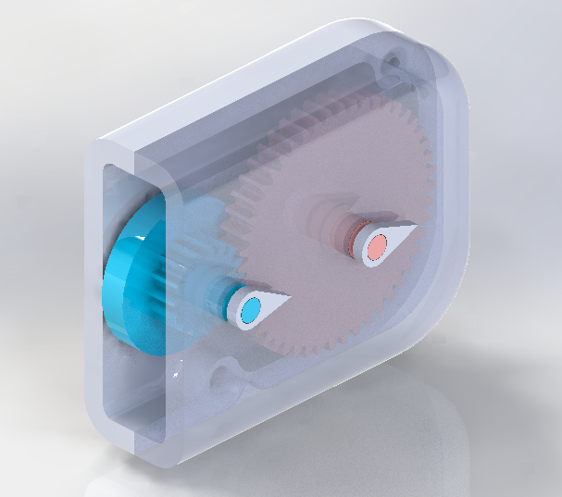
Cycle #2 CAD
Decreased size and less parts for easier printing
Remove one gear
Only measures up to 1 foot
Increased Tolerance
Wheel
Dial Indicators

